Slide 2
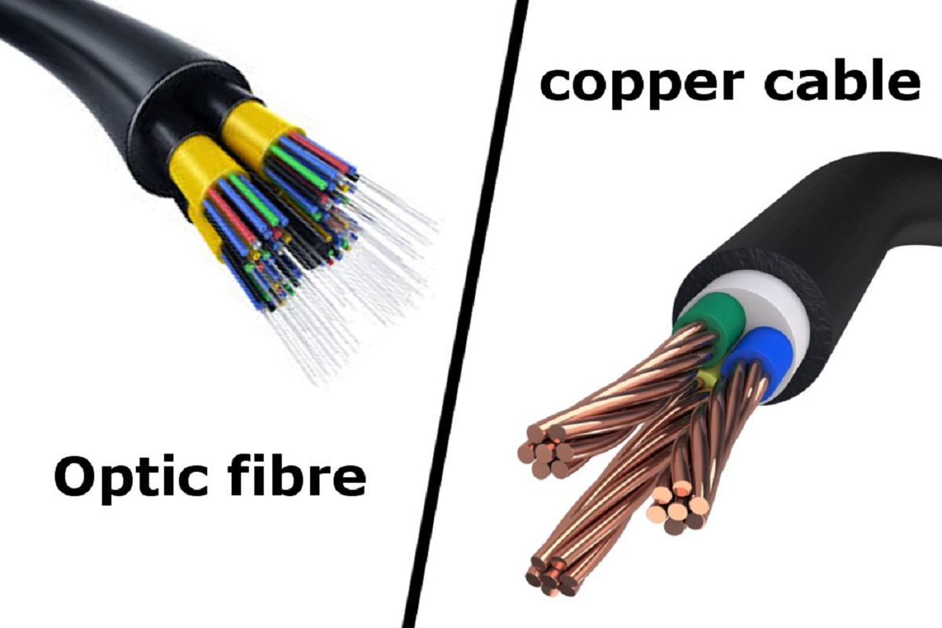



Slide 3


Server
Server

Slide 4
69.63.176.140
facebook.com
72.14.205.100
google.com

Slide 5
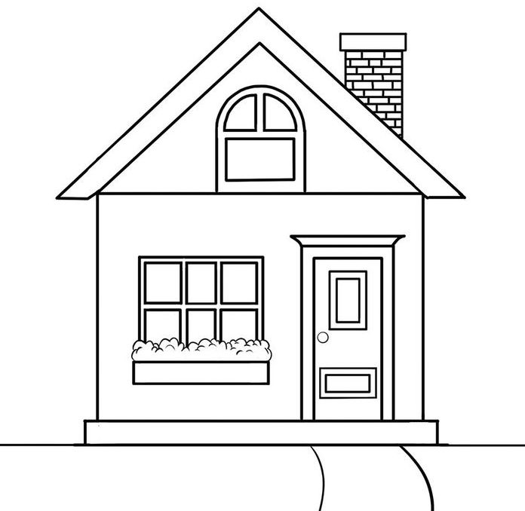
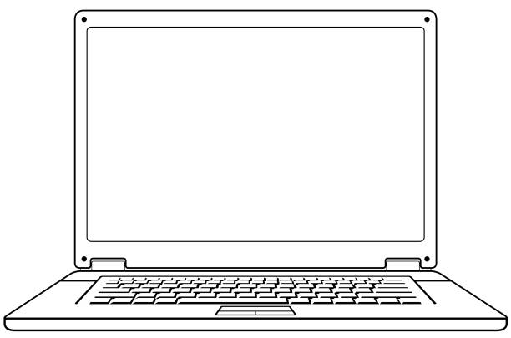
Orange.fr
(Server & ISP)
ISP
Gmail.com

Slide 6
Orange.fr
(Server & ISP)
ISP
DSL
Gmail.com

Slide 7
DSL
Orange.fr
(Server & ISP)
Paul
ISP
DSL
Gmail.com

Slide 8

DSL
Orange.fr
(Server & ISP)
Paul
ISP
DSL
Gmail.com

Slide 9
DSL
Orange.fr
(Server & ISP)
Paul
ISP
DSL
Gmail.com

Slide 10
DSL
Orange.fr
(Server & ISP)
Paul
ISP
DSL
Gmail.com

Slide 11








Slide 18
69.63.176.140
facebook.com
72.14.205.100
google.com
You
192.168.1.10
ISP
Boss
192.168.1.11

Slide 19
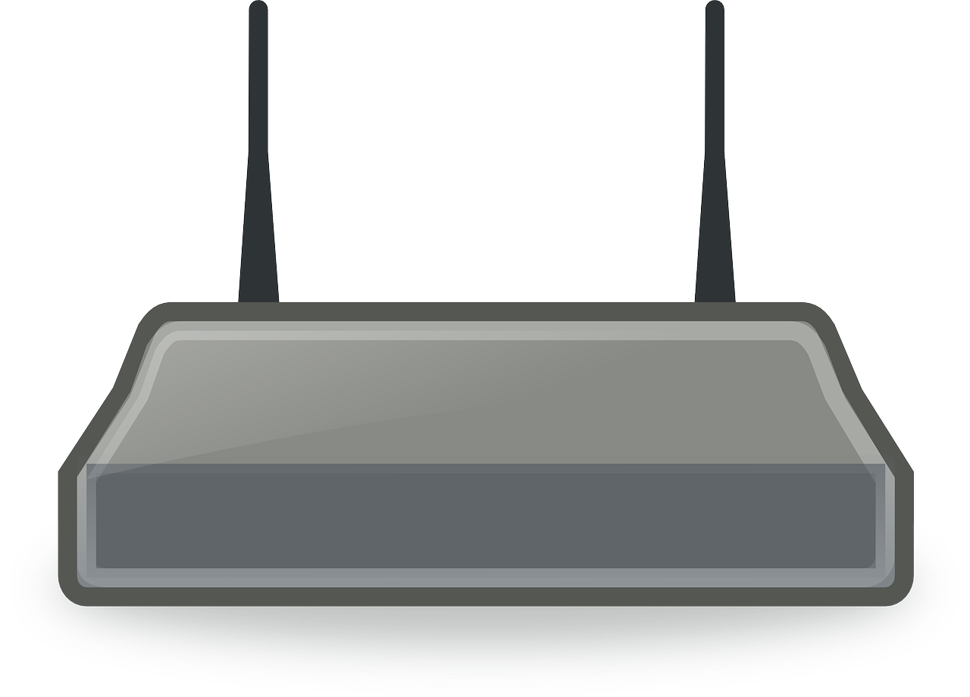
69.63.176.140
facebook.com
72.14.205.100
google.com
You
192.168.1.10
ISP
Boss
192.168.1.11

Slide 20
69.63.176.140
facebook.com
72.14.205.100
google.com
You
192.168.1.10
ISP
Boss
192.168.1.11

Slide 21
69.63.176.140
facebook.com
72.14.205.100
google.com
You
192.168.1.10
ISP
Boss
192.168.1.11

Slide 22
69.63.176.140
facebook.com
72.14.205.100
google.com
You
192.168.1.10
ISP
Boss
192.168.1.11

Slide 23
69.63.176.140
facebook.com
72.14.205.100
google.com
You
192.168.1.10
ISP
Boss
192.168.1.11

Slide 24
69.63.176.140
facebook.com
72.14.205.100
google.com
You
192.168.1.10
ISP
Boss
192.168.1.11

Slide 25
69.63.176.140
facebook.com
72.14.205.100
google.com
You
192.168.1.10
ISP
Boss
192.168.1.11

